Slide 1

Continuous-variable Quantum Neural Network
Natchapol Patamawisut

Slide 2
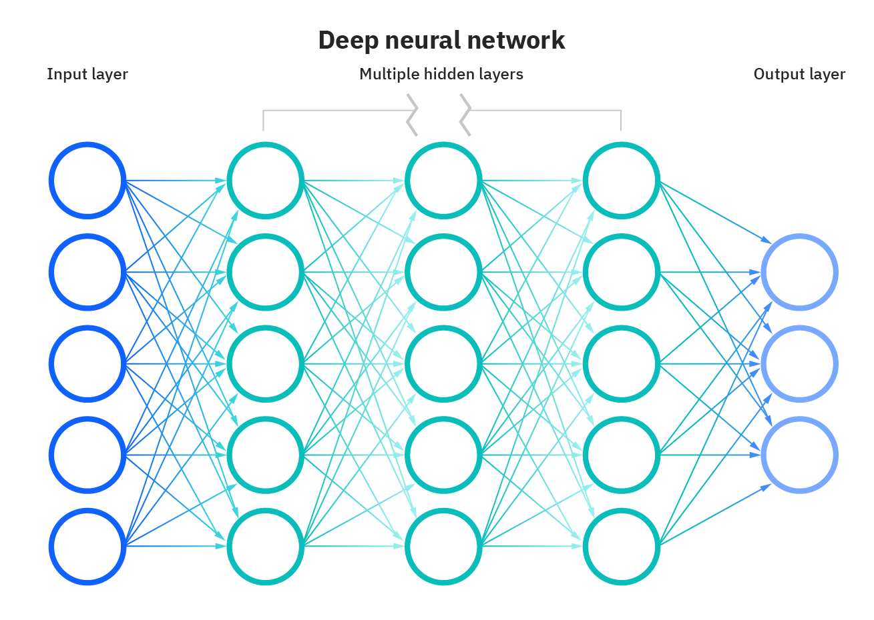
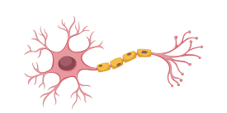
Neural Network
are a subset of machine learning and are at the heart of deep learning algorithms. Their name and structure are inspired by the human brain, mimicking the way that biological neurons signal to one another.

Slide 3
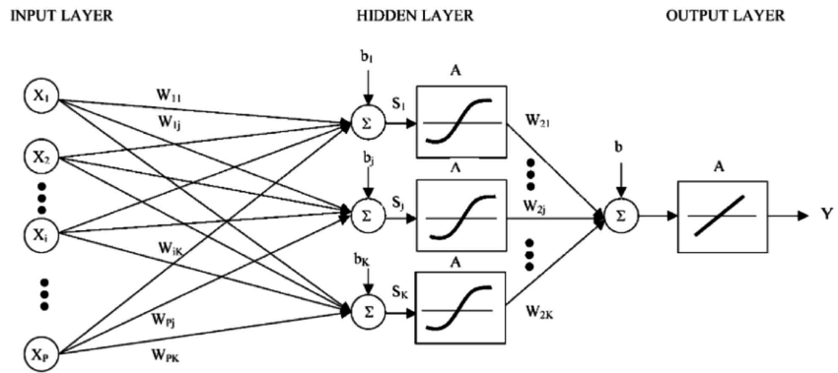
Neural Network Structure
1 “K Node” Hidden Layer

Slide 4
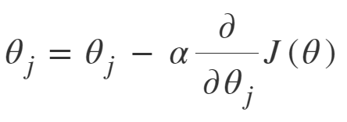
Backpropagration Algorithm
Error(Prediction(Y), Actual)

Slide 5
Neural Network Structure
2
1
3
4

Slide 6
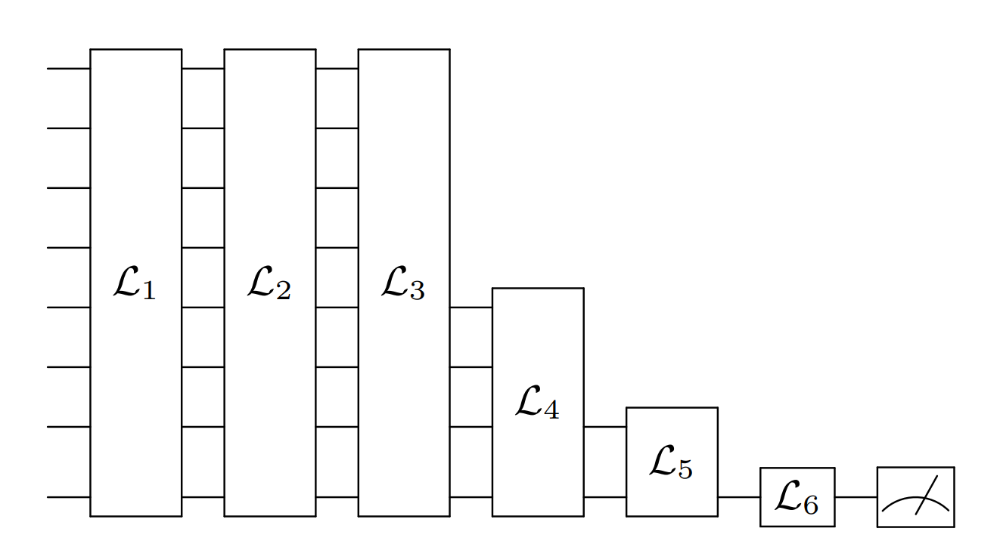
Continuous-variable Quantum Neural Network
Is variational circuit built in the continuous-variable (CV) architecture, which encodes quantum information in continuous degrees of freedom.

Slide 7
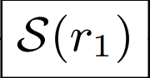
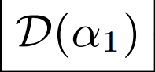
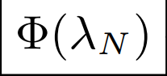
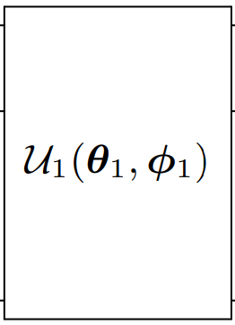
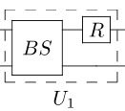
Classical Vs CV Quantum Neural Network

Slide 8
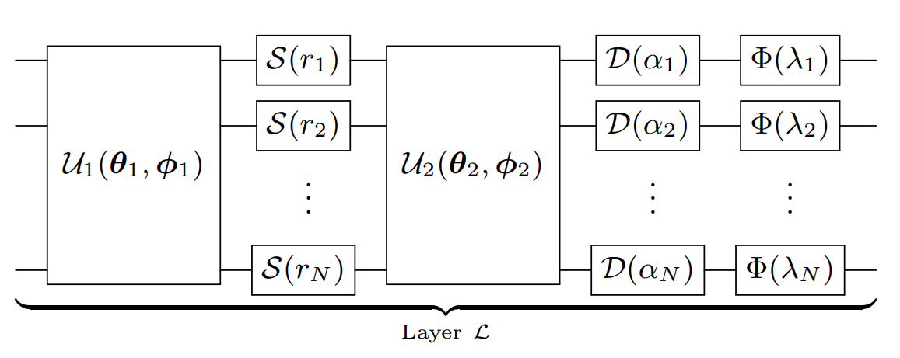
CV Quantum Layer

Slide 9
Backpropagration Algorithm
Error(Prediction(Y), Actual)

